Slide 1
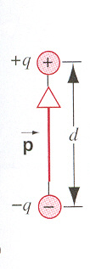
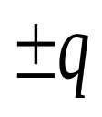

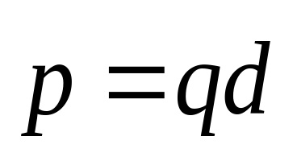
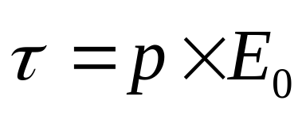
The Electric Dipole
Electric Dipole : The configuration of two equal and opposite charges separated by a small distance .
q
E₀
−q
E₀

Slide 2
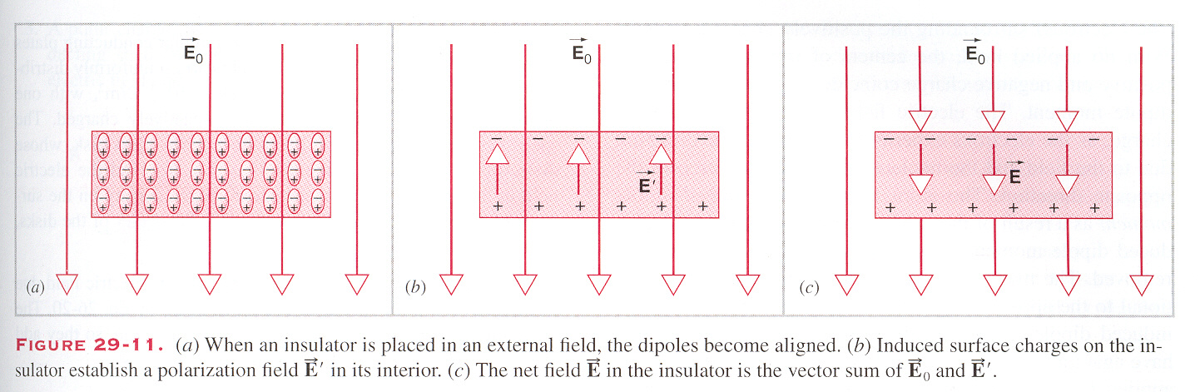
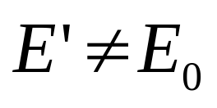
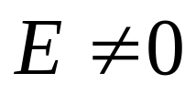
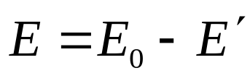
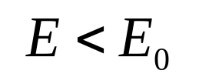
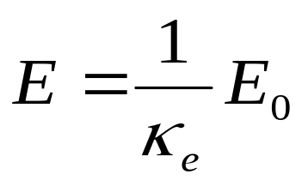
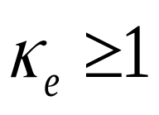
To describe this weakness of the electric field in an insulator, we often define the dimensionless “dielectric constant” k_{e} :
Inside the insulator,

Slide 3
There is a decrease of the electric field in an insulator.
How dose magnetic field in the material?

Slide 4
Chapter 35 Magnetic Properties of Materials

Slide 5
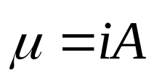
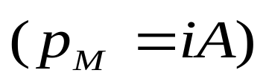
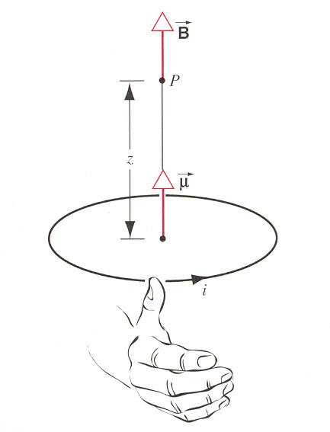
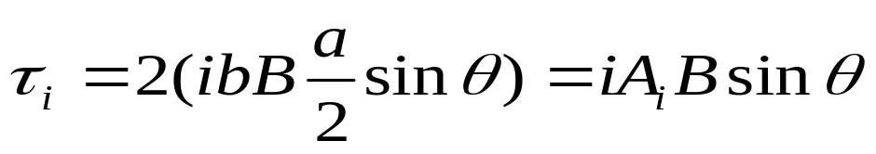
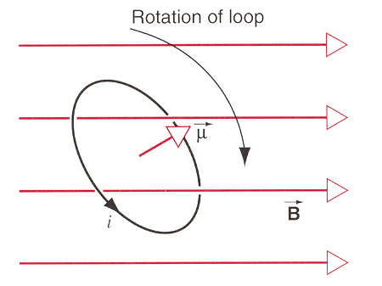
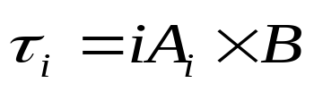
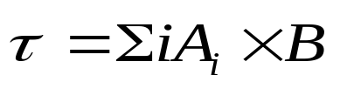


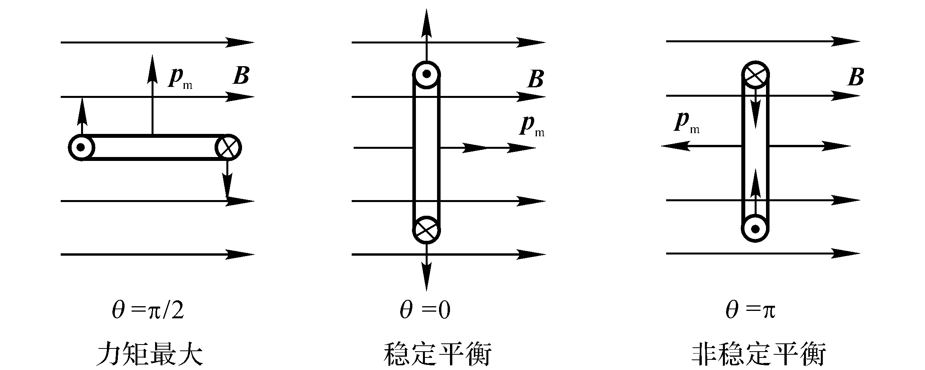
The Magnetic Dipole
Magnetic dipole
b
a
μ
μ
μ

Slide 6
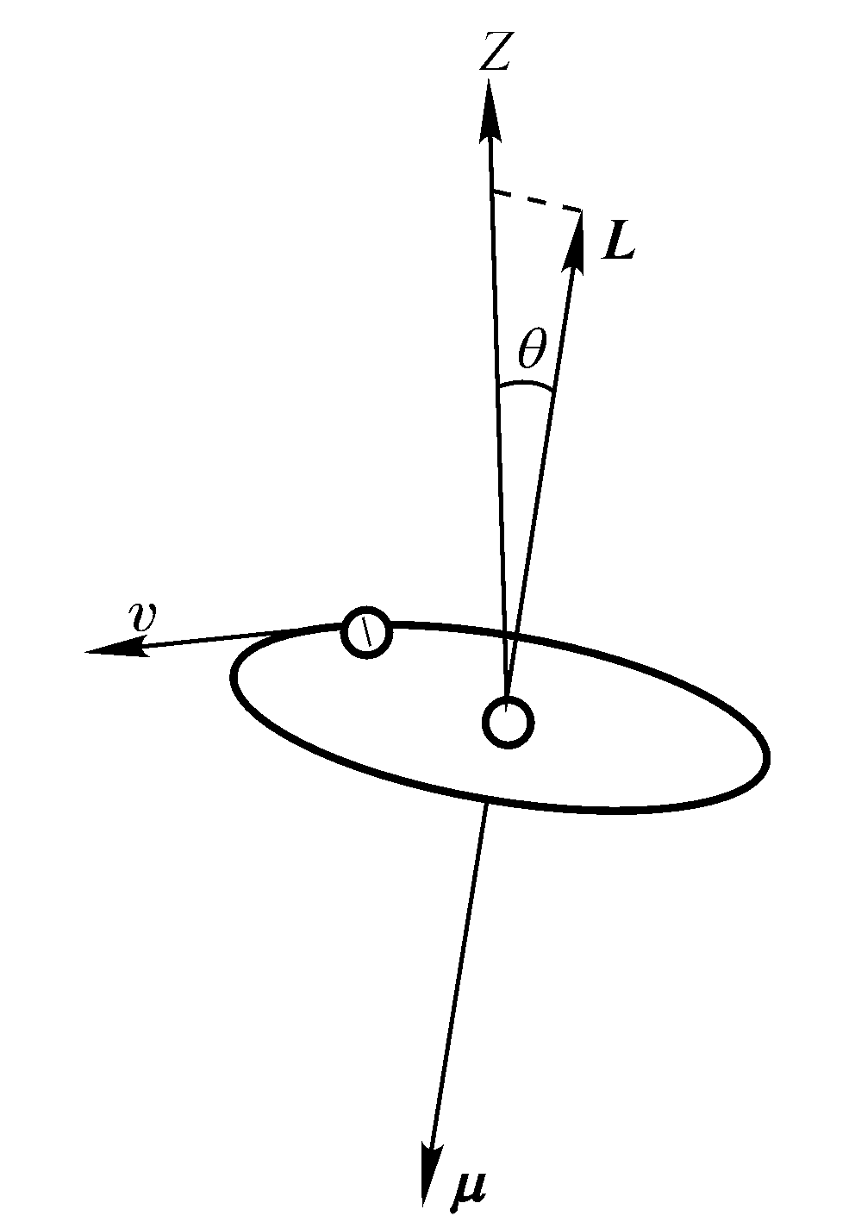
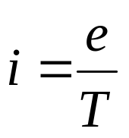
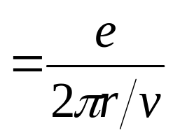
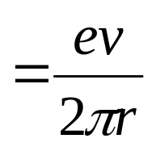
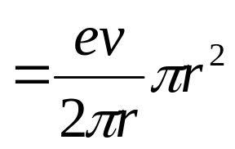
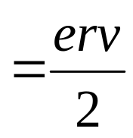

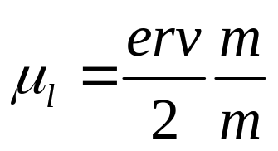
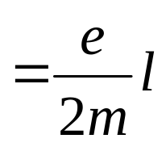

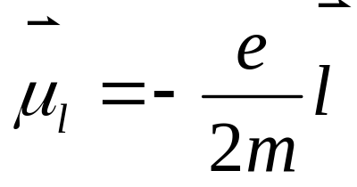
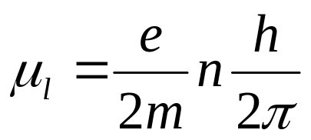
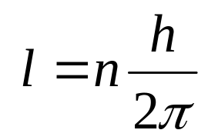
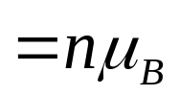
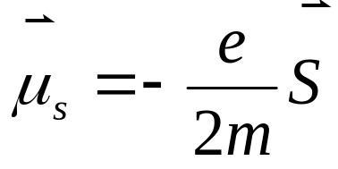
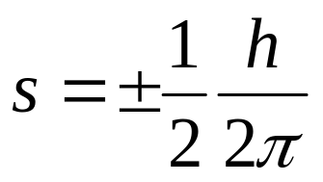
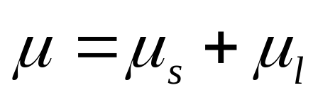
Atomic and Nuclear Magnetism
Orbital magnetic dipole moment
Orbital magnetic dipole moment
Bohr magneton
Spin magnetic dipole moment

Slide 7
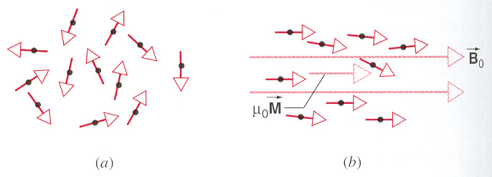
Magnetization
unmagnetized
magnetized

Slide 8
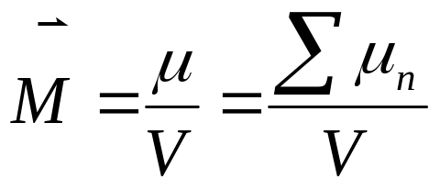
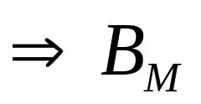
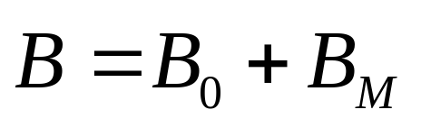
Magnetization
unmagnetized
magnetized
magnetization M:
There are three field: applied magnetic field B₀, magnetized field B_{M}, net magnetic field B.

Slide 9
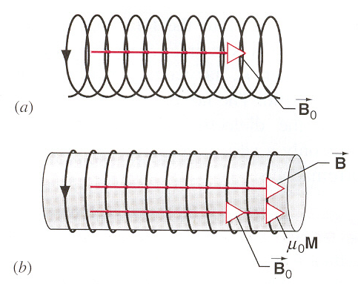
a long solenoid
with a magnetic material

Slide 10
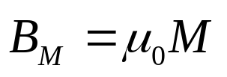
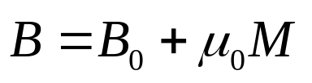
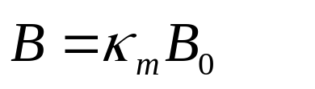
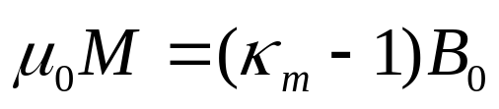

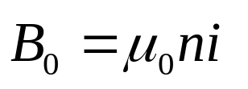
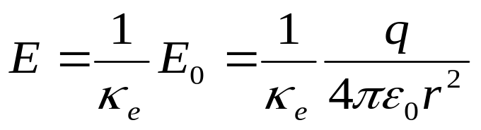
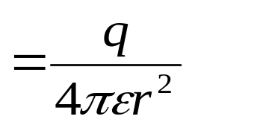
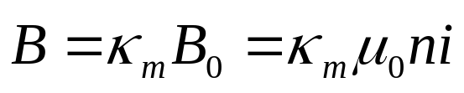

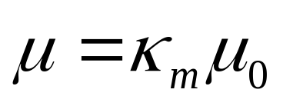
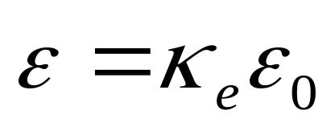
a long solenoid
with a magnetic material

Slide 11
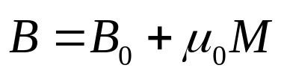








Electric Field
Magnitic Field
surface charge
surface current

Slide 12




Electric Field
Magnitic Field
Paramagnetism
Diamagnetism
surface current

Slide 13


Magnetic Materials
1. Paramagnetism
The atoms of this material have permanent magnetic dipole moments. B₀ and μ₀M are parallel, B > B₀.
B₀ increase
M increase
when B₀/T is small
Curie’s Law

Slide 14



2. Diamagnetism
B₀ and μ₀M are antiparallel, B < B₀.
motion
Δμ_{m}

Slide 15
2. Diamagnetism
B₀ and μ₀M are antiparallel, B < B₀.
motion
ΔP_{m}

Slide 16
2. Diamagnetism
B₀ and μ₀M are antiparallel, B < B₀.
motion
ΔP_{m}
Δμ_{m}

Slide 17
2. Diamagnetism
B₀ and μ₀M are antiparallel, B < B₀.
motion
ΔP_{m}
Δμ_{m} is antiparallel with B.
μ_{m} is parallel with B.
ΣΔμ_{m} < Σ μ_{m}
Paramagnetism
ΣΔμ_{m} > Σ μ_{m}
Diamagnetism

Slide 18



1. Paramagnetism
B₀ and μ₀M are parallel, B > B₀ κ_{m}>1
2. Diamagnetism
B₀ and μ₀M are antiparallel, B < B₀ κ_{m}<1
3. Ferromagnetism
κ_{m}>>1, B >> B₀.
T>T_{C}, Paramagnetism.
Magnetic domains
B₀=0
B₀

Slide 19




1. Paramagnetism
B₀ and μ₀M are parallel, B > B₀ κ_{m}>1
2. Diamagnetism
B₀ and μ₀M are antiparallel, B < B₀ κ_{m}<1
3. Ferromagnetism
Hysteresis
κ_{m}>>1, B >> B₀.
T>T_{C}, Paramagnetism.
Point c: remains magnetized even when the applied field B₀ is zero.
Point e: retains a permanent magnetization.
Ferromagnetism can “remember” how it became magnetized.

Slide 20














Nuclear magnetism
The nucleus has a magnetic moment with two parts: orbital magnetic moment of protons and intrinsic magnetic moment of protons and neutron.
protons and neutrons
Nuclear magnetic resonance

Slide 21



Gauss’ Law for Magnetism
The magnetic form of Gauss’law: The net flux of the magnetic field through any closed surface is zero.

Slide 22






Example

Slide 23



Example

Slide 24










Example

Slide 25










Example

Slide 26
Exercises
P818-820 7, 11, 17, 31
Problems
P820 3

Slide 27






Electric Field
Magnetic Field

Slide 28






Electric Field
Magnetic Field

Slide 29





Electric Field
Magnetic Field

Slide 30




Induction

Slide 31






Electric Field
Magnetic Field

